Slide 1


PowerPoint Presentation: CMCS - PROG6212 Final POE
Title: Contract Monthly Claim System (CMCS)
Subtitle: PROG6212 Final Portfolio of Evidence (POE)
Name: Muvhumbi Motseo
Student Number: st10055316
Institution: Independent Institute of Education Emeris
Date: 21 November 2025

Slide 2
Project Overview
Title: What is the CMCS?
Content:
  A comprehensive web-based system for managing monthly contract claims for lecturers.
  Implements a multi-role workflow.
  Key Roles:
    HR (Super User): Manages all users.
    Lecturer: Submits and tracks claims.
    Programme Coordinator: First-level approval.
    Academic Manager: Final approval

Slide 3
Updates from Part 2 to Part 3
Title: Addressing Lecturer Feedback
Content:
  HR as Super User: Full user lifecycle management; public registration disabled.
  Enhanced Lecturer View: Hourly rate auto-pulled from HR; auto-calculation; 180-hour validation.
  Session Management: Comprehensive implementation as per module requirement.
  Authorization & Security: Role-based access control; users cannot access unauthorized pages.
  Report Generation: Using LINQ for data analysis and report creation.

Slide 4
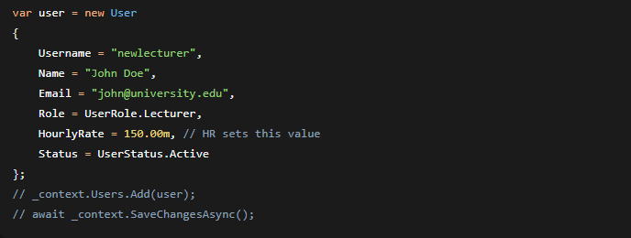
Key Feature 1: HR Super User Dashboard
Title: HR Super User - Centralized Control
Content:
  HR creates all users and sets their hourly rates.
  No public registration.
  Code Snippet (User Creation - C#):
  Explanation: This code shows how HR creates a user profile, explicitly setting the HourlyRate that the lecturer will use.

Slide 5
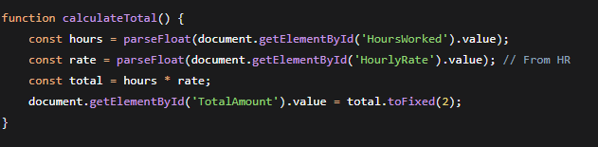
Key Feature 2: Lecturer Auto-Calculation & Validation
Title: Streamlined Claim Submission
Content:
  Hourly rate is auto-populated from the HR-set value.
  Real-time auto-calculation of Total Amount = Hours × Rate.
  Server-side validation enforces the 180-hour monthly maximum.
  Code Snippet (JavaScript for Auto-Calculation):
  Explanation: This client-side script provides immediate feedback to the lecturer as they enter their hours.

Slide 6
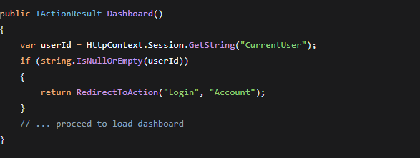
Key Feature 3: Session Management
Title: PROG6212 Requirement: Session Implementation
Content:
  User data is stored in session upon login.
  Session is validated on every protected page/action.
  Essential for maintaining user state and security.
  Code Snippet (Session Check - C#):
  Explanation: This controller code is a gatekeeper, ensuring only logged-in users can access the dashboard.

Slide 7
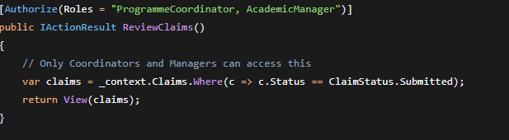
Key Feature 4: Authorization & Security
Title: Ensuring Role-Based Access
Content:
  [Authorize] attributes on all controllers.
  Role-based checks prevent unauthorized access.
  Automatic redirection to login if unauthorized.
  Code Snippet (Role Authorization - C#):
  Explanation: This attribute restricts the ReviewClaims action to users with either the ProgrammeCoordinator or AcademicManager role.

Slide 8
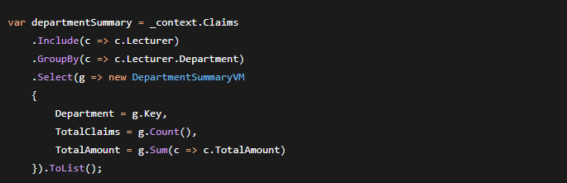
Key Feature 5: LINQ Report Generation
Title: Data Analysis with LINQ
Content:
  HR can generate various reports using LINQ queries.
  Example: Department-wise claim summary.
  Code Snippet (LINQ GroupBy - C#):
  Explanation: This powerful LINQ query groups claims by department and calculates totals, showcasing the use of LINQ for reporting as required.

Slide 9
Database & Technology Stack
Title: Under the Hood
Content:
  Database: SQL Server with Entity Framework Core (Code-First).
  Backend: ASP.NET Core 6.0 MVC
  Authentication: Cookie-based
  Frontend: Bootstrap 5, JavaScript
  Session: ASP.NET Core Session Middleware

Slide 10
PROG6212 Checklist Compliance
Title: Meeting the Brief
Content (in checklist format):
  HR View: Super User, User Management, LINQ Reports, No Register.
  Lecturer View: Auto-rate, Auto-calculation, 180h Validation, Claim Tracking.
  Admin Views: Separate Coord/Manager roles, Sessions, Authorization.
  Version Control: 10+ descriptive commits on GitHub.
  Documentation: Updated README with Part 3 changes.

Slide 11
Demonstration Walkthrough
Title: Video Demonstration Highlights
Content:
  HR creating a user and setting an hourly rate.
  Lecturer logging in, submitting a claim (showcasing auto-calculation).
  Triggering the 180-hour validation error.
  Programme Coordinator approving a claim.
  Academic Manager giving final approval.
  Demonstrating session and unauthorized access prevention.
  HR generating and downloading a report.

Slide 12
Title: Thank You
Content:
  Successfully delivered a robust CMCS meeting all PROG6212 requirements.
  Implemented key feedback from Part 2.
  Demonstrated understanding of MVC, EF Core, Sessions, LINQ, and Security.
Questions?

